Slide 1

Reverse engineering an ad
By
KEVIN

Slide 2



Slide 3
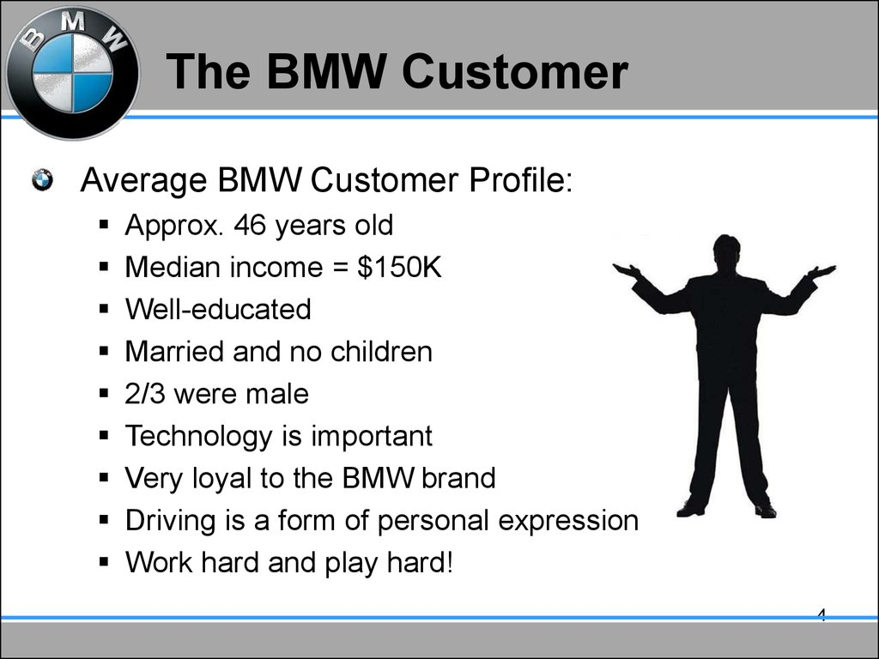

Slide 4
CARS SOLD IN INDIA |  | CARS SOLD IN USA | CALCULATION
45.60% |  | 73.50%
49.90% |  | 71.90% | P = 0.004969
53.20% |  | 81.90%
70.80% |  | 75.60%
63.60% |  | 89.33%

Slide 5
TWO SAMPLE T TEST
Y = SALES (continues)
X = COUNTRIES (discrete)
P = 0.004696 , α = 0.05
P is low ,null rejected
So there is a difference in sales between the two countries.

Slide 6
